Slide 1


CRIME OR SAFETY????

Slide 2
Imagine waking up in the morning and watching the news on TV. You hear a devastating news which will ruin your mood the whole day that a celebrity got murdered or there has been multiple gun shots at mall. You keep thinking about it at work the whole day and you couldn’t perform as well as you do at work. You may not think it, but it affects us every day. While everyone desires safety, achieving 100% safety is an unreachable goal. Nevertheless, thanks to the efforts of law enforcement and dedicated individuals, our world is made safer each day... A dream of mine maybe ,FBI to see the work I did so I can work with them as a data analyst. My experience working with the Rutgers University Police Department as a CSO has sparked a passion for making small changes that contribute to a safer environment for students, faculty, and professors. This realization led me to choose crime data as the focus of my capstone project. There is a lack of awareness among people about the intricacies of crime data, and my goal is to make a modest contribution to creating a safer society. I wanted to bring that goal combined with my Data Analytics skills using SQL to validate the data , clean it and did few analytics to preprocess it & Tableau to present my findings .
What is Crime and Why I have chosen Crime Data ??

Slide 3
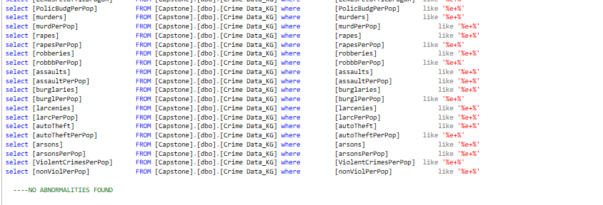
Have loaded the 3 data files into SQL Server Using Microsoft Access . After loading it , have validated the loaded data if the data got loaded properly checking any row duplicates. Got 200 row duplicates and used a SQL code to delete them. Have checked for E+ values for numerical value columns. For one data , found 100 E+ values. So, I have deleted the table in SQL. Changed the following column in the raw data excel from number format to general and loaded it again and got no E+ Values . Have done some analytics by changing the date format and concating few columns to the proper format. Did grouped by for age column doing analysis on it and saved it in the proc. Then after analysis on SQL , have loaded the SQL data into Tableau.
Preprocessing the Data

Slide 4
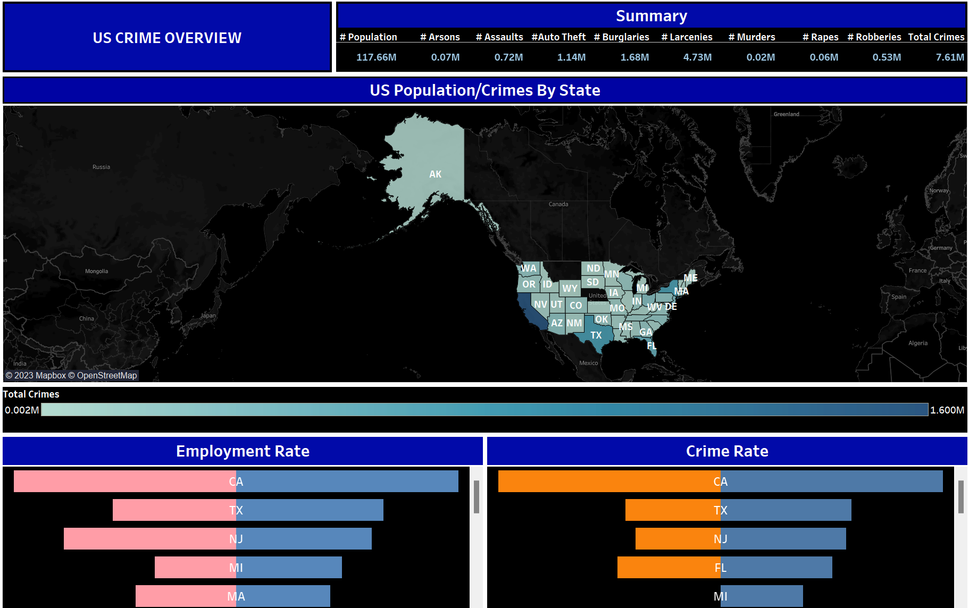
Dashboard 1:

Slide 5
1.This dashboard illustrates crime trends across the United States in the year 2018 and incorporates three visualizations. 2.The initial visualization presents a map chart depicting total crimes in the United States, with legends showcasing crime rates and additional information on total population provided in the tooltip. Notably, California emerges as the state with the highest incidence of crimes. Hovering over any state reveals its name, the total crimes reported in 2018, and the corresponding total population. 3.The second visualization employs a butterfly chart, distinguishing between employment (pink) and unemployment (blue) figures. Given California's substantial population, it tops both categories, while Texas follows closely, particularly in terms of unemployment. A plausible inference might connect unemployment rates to increased crime, possibly stemming from factors like illiteracy and joblessness. 4.The third visualization, another butterfly chart, contrasts the orange color representing violent crimes per population against the blue color indicating non-violent crimes per population. California stands out with the highest counts in both categories. Thus, the dashboard suggests a potential correlation between less stringent laws, California's high population of approximately 22.2 million, and elevated crime rates in the state.

Slide 6
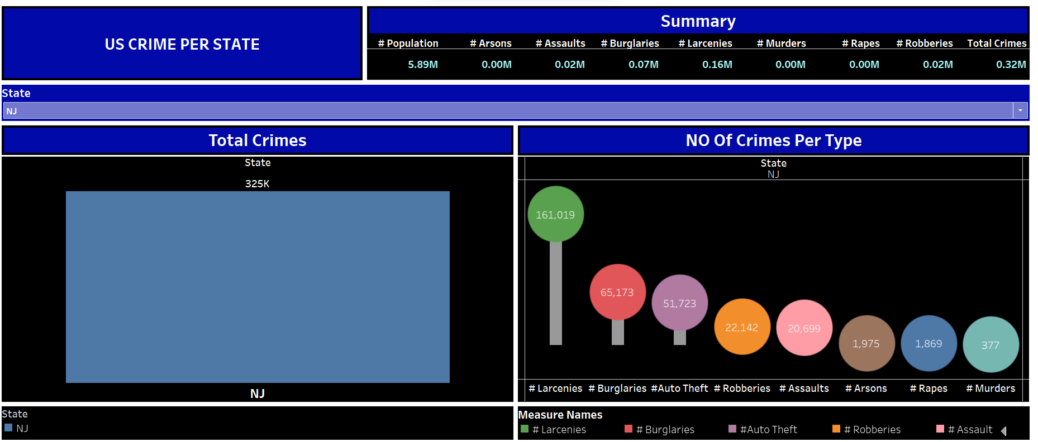
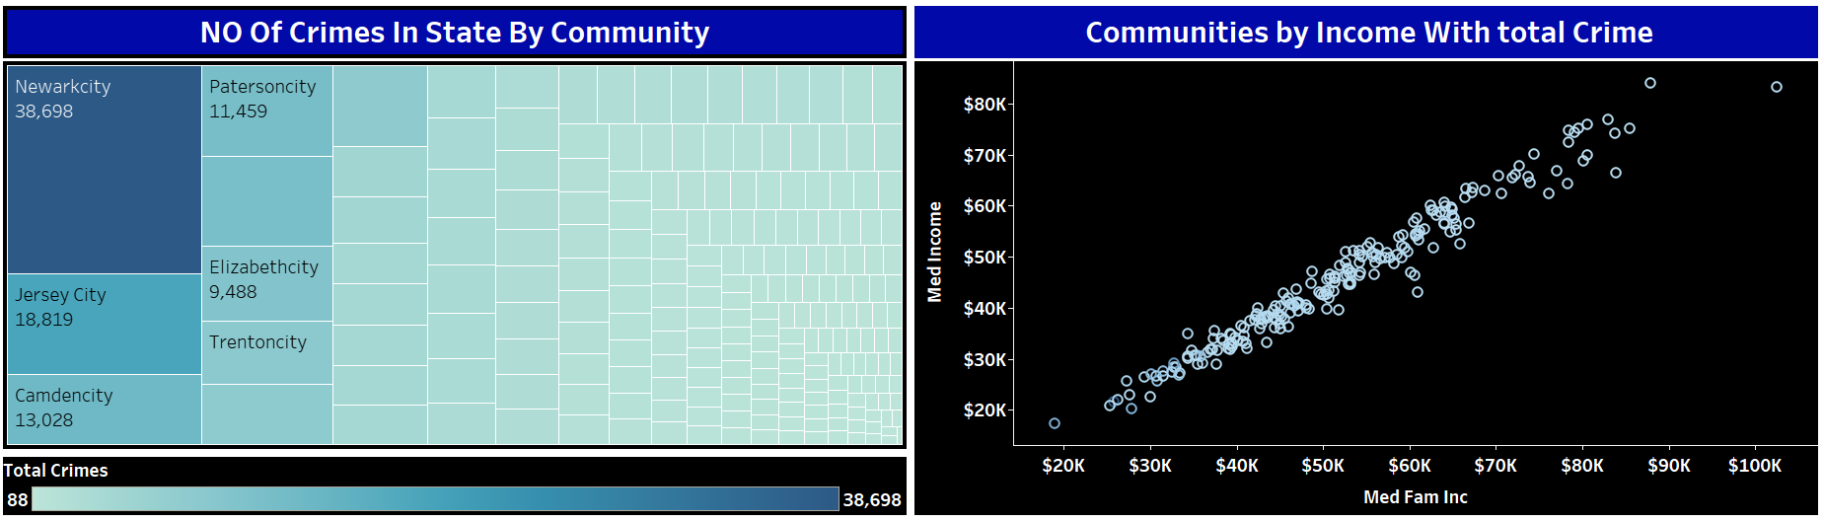
Dashboard 2:

Slide 7
1.This dashboard meticulously depicts crime statistics on a state-specific level for the year 2018, comprising four interconnected visualizations. To enhance focus and relevance, a state filter has been applied, with New Jersey (NJ) chosen for detailed examination, reflecting my current residence. 2.In the initial visualization, the total number of crimes in NJ is prominently displayed, amounting to 325,000 reported incidents. 3.The second visualization employs a Lollipop Chart, delineating crime types and their respective frequencies in the state. Notably, larcenies emerge as the most prevalent crime, totaling 1.6 million, followed by burglaries (65,000) and robberies (51,000). This insight prompts considerations for public safety, urging individuals to secure personal belongings and possibly implement enhanced security measures. 3.The third visualization, a tree map, organizes total crimes by community name, revealing Newark as having the highest crime rate compared to Jersey City and Camden. Given Newark's downtown location and potential limited police presence, caution is advised, particularly against solo travel during late hours. 4.The fourth visualization, a scatter plot, correlates median family income and median income per community with total crimes, using Milburn Township as an exemplary case. The graph illustrates that higher income areas, such as Milburn, tend to experience lower crime rates, emphasizing the potential impact of economic factors on criminal activity. In contrast, Newark City, with lower income levels, demonstrates a higher incidence of crimes, suggesting a correlation between economic hardships and certain property crimes. This comprehensive analysis underscores the significance of economic conditions and safety measures in shaping community crime dynamics.

Slide 8
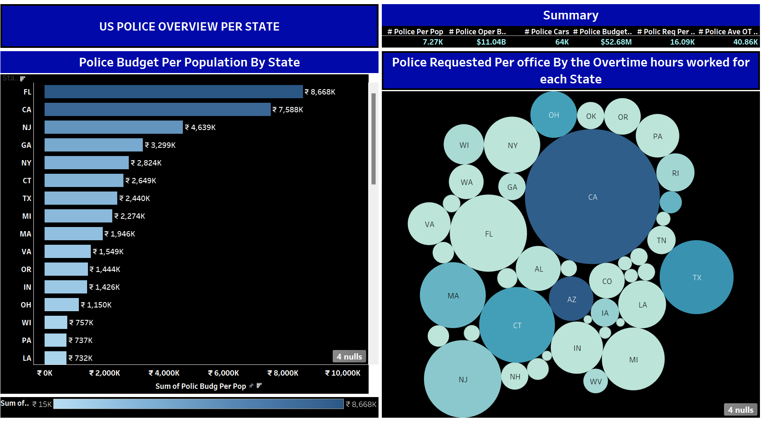
Dashboard 3:

Slide 9
1.This dashboard offers an insightful overview of the policing landscape in the United States for the year 2018, incorporating two compelling visualizations. 2.The initial visualization delves into the total budget allocated to police forces across states. Notably, Florida (FL) emerges with the highest budget at $8668K, followed closely by California (CA). While a higher police budget theoretically suggests increased law enforcement presence, better equipment, and enhanced training—factors contributing to improved crime prevention and response—a nuanced analysis of California reveals potential inefficiencies, lack of strategic planning, or mismanagement hindering the effectiveness of law enforcement efforts. This observation underscores the importance of evaluating policing practices, addressing issues such as excessive force, limited community engagement, and concerns regarding accountability and transparency that may impede crime reduction initiatives. 3.The second visualization adopts a bubble chart format, providing a comprehensive view of police overtime hours worked and the corresponding number of officers requested in 2018. The bubble sizes, indicative of total hours worked, reveal that California leads with an astonishing 8878 hours of overtime—a staggering equivalent of approximately 370 days of continuous, 24/7 work. This data aligns with California's status as the state with the highest crime rates. The inference drawn is that the substantial overtime hours may be a strategic response to the heightened demand for law enforcement resources in combating crime, with 2432 officers requested. This correlation prompts a deeper understanding of the intricate relationship between crime rates and the demands placed on law enforcement personnel.

Slide 10
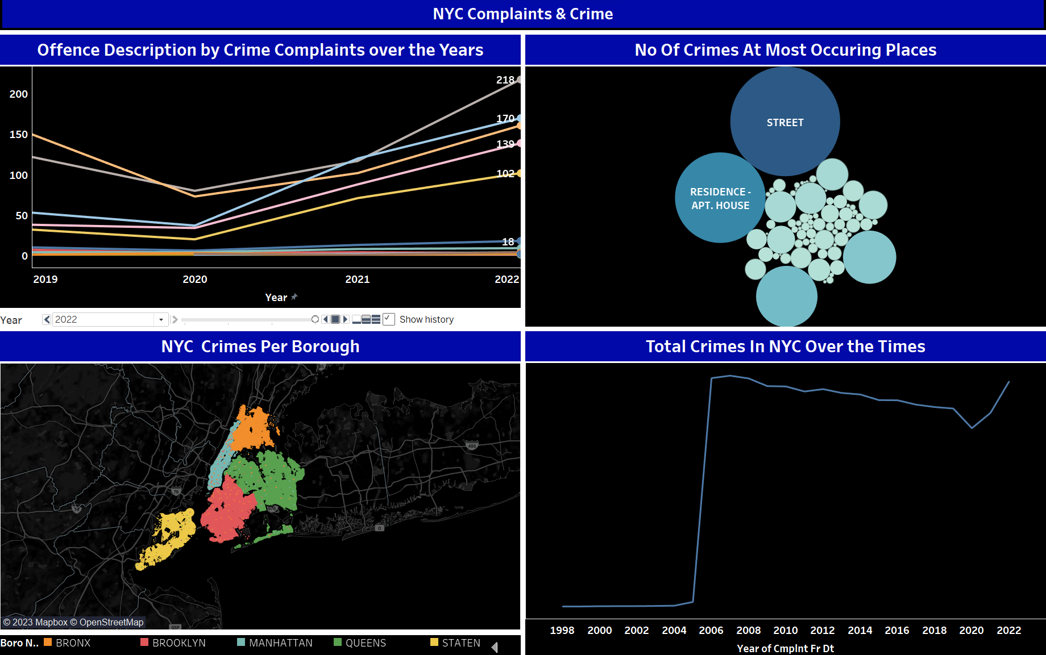
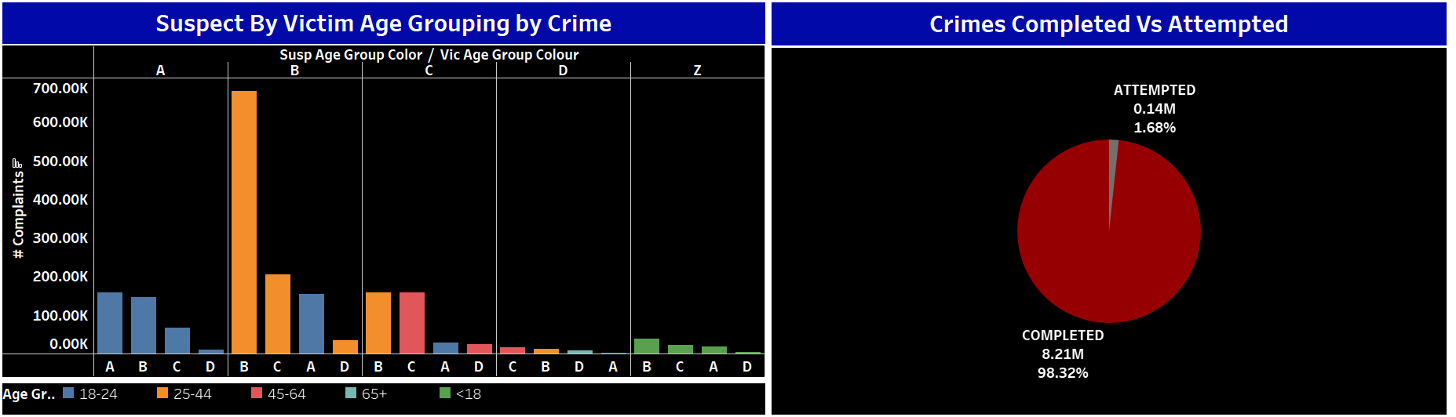
Dashboard 4:

Slide 11
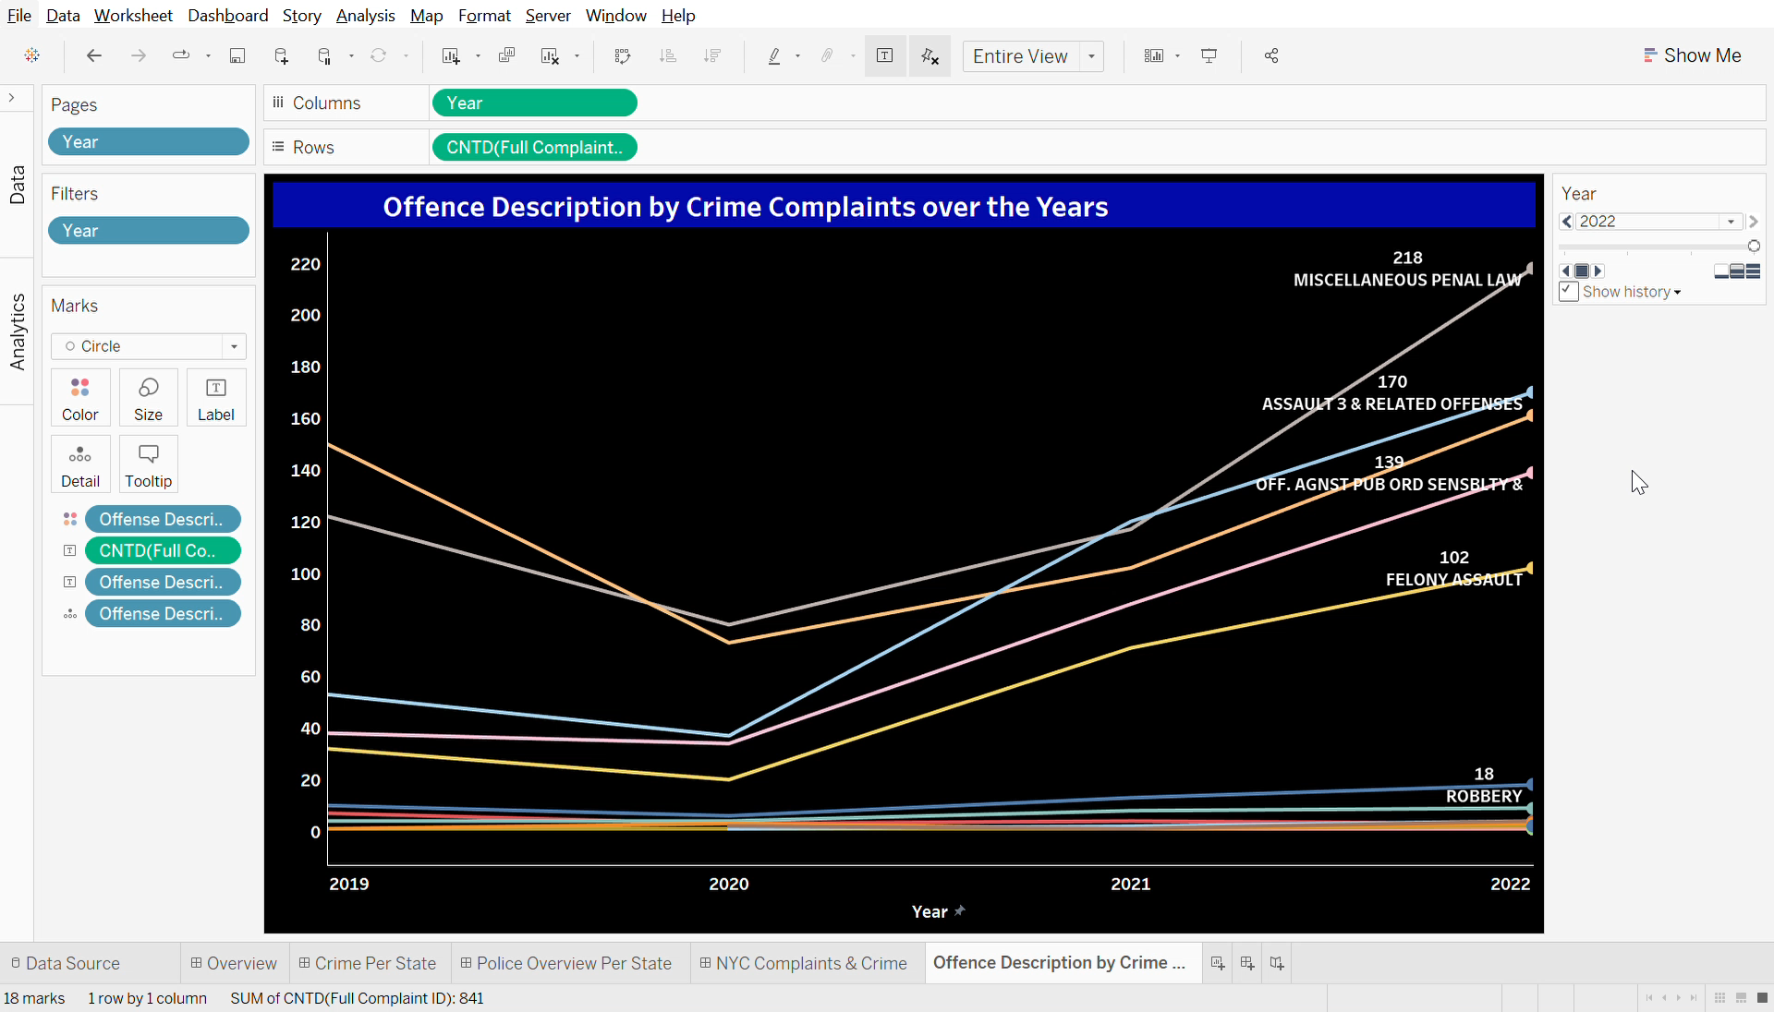
1.This final dashboard encapsulates six visualizations derived from a distinct dataset, focusing on New York City's total crimes and complaints over the years. The dataset encompasses all valid felony, misdemeanor, and violation crimes reported to the New York City Police Department (NYPD). 2.In the 1st visualization, an interactive line chart unfolds, presenting the offense descriptions through crime complaints spanning the years 2019 to 2022. A meticulous analysis of the visualization reveals that in 2019, Criminal Mischief recorded the highest count at approximately 150, followed by Miscellaneous Penal Law with around 122 instances, and Assault 3 & Related Offenses at approximately 53 cases. Fast-forwarding to 2022, the landscape has shifted significantly, with Miscellaneous Penal Law surging to 218 incidents, claiming the top spot. Concurrently, Assault 3 & Related Offenses witnessed a substantial increase to around 170, securing its position as the second most prevalent offense category. This nuanced exploration of the data offers a temporal narrative, unraveling the evolving patterns in crime complaints over the specified period.
Visualization 1:

Slide 12
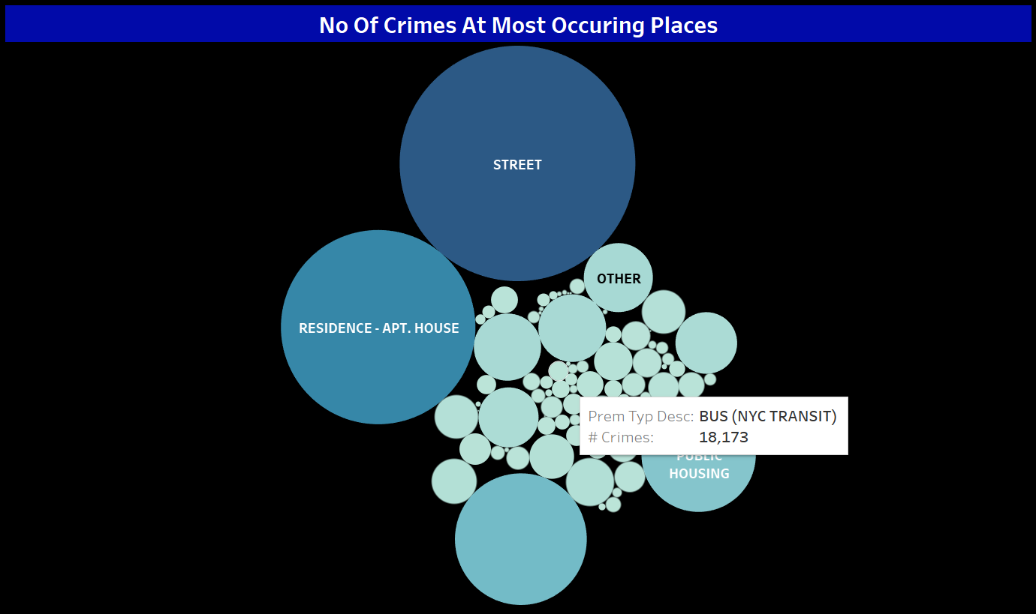
1. In the 2nd Visualization, it states the No of crimes occurring at the most occurring places and kept the size by the number of crimes which have shown as bubble chart. So, from the chart, we can see that most of the crimes happen mostly in the street around 26M crimes data over the years followed by residence-apt house around 17M crimes . So have made this Visualization to see the highest number of crimes happening at which places and to suggest reducing the crimes happening. To conclude to reduce the No of crimes happening maybe increasing the police forces and follow a bit strict timeline curfew to be safe. The integration of technology, such as surveillance cameras and data analytics, can also further enhance law enforcement capabilities. In conclusion, the coordinated implementation of these strategies, rooted in community engagement and preventative measures, is vital for effectively mitigating street-level crimes or etc. in New York City and fostering a safer urban environment for all residents.
Visualization 2:

Slide 13
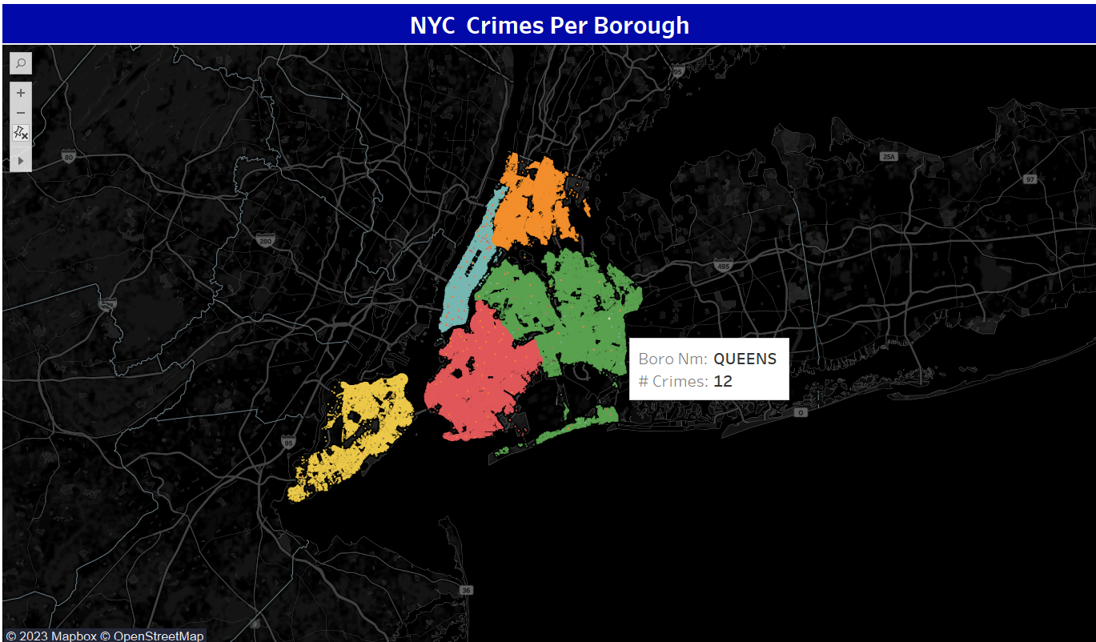
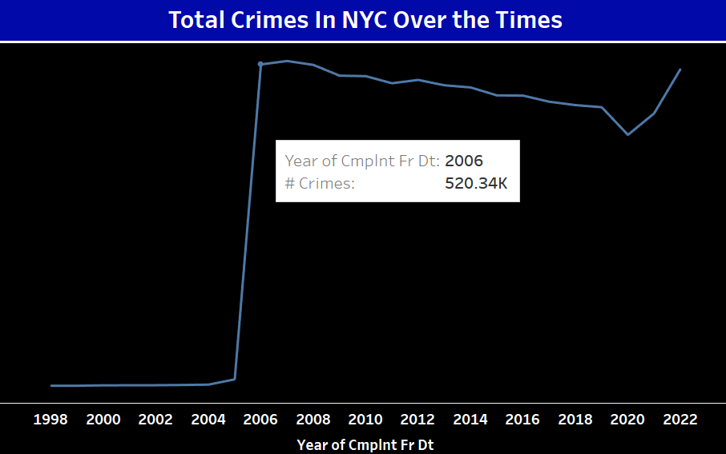
1. In the 3rd Map Visualization , it shows the No of crimes happening per area of the borough type .Have kept the latitude column and latitude column for the map viz. Have kept the borough name as legend. As seen from the map above as we hover any area from the borough, we can see the name of the borough and the No of crimes happening.
Visualization 3 & 4:
In the 4th Visualization which is a line chart states the number of crimes happened over the years. From analyzing the graph, we can infer that there has been a drastic increase in the No of crimes for the year 2006 which was 520.34K Crimes as in the year 2005 it was 10.69K crimes. It has increased a lot . We can conclude that the surge in crime rates in New York City during the year 2006 can be attributed to a confluence of factors that collectively contributed to a challenging socio-economic landscape. Economic disparities and rising unemployment rates, exacerbated by broader national economic trends, likely fueled criminal activities, especially in economically marginalized neighborhoods. Additionally, shifts in law enforcement strategies or resource allocations during this period may have impacted crime reporting practices, leading to an apparent spike in recorded incidents.

Slide 14
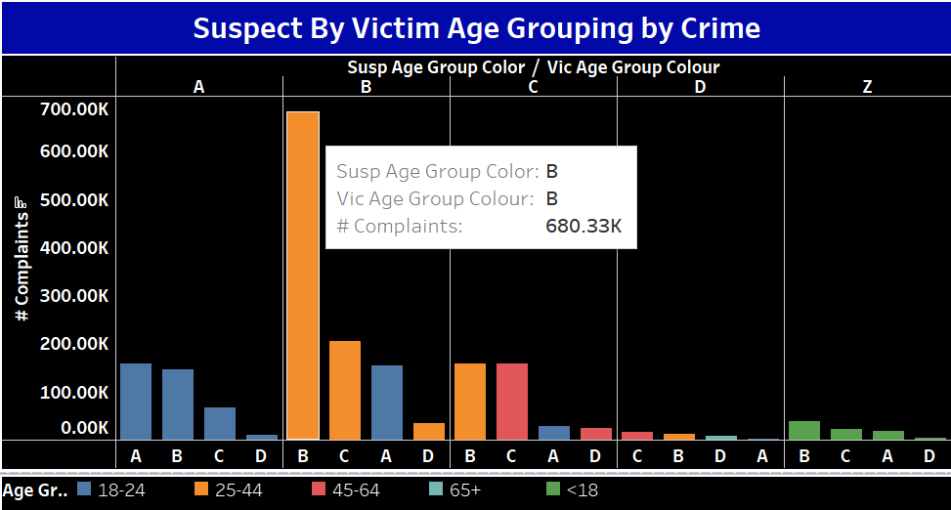
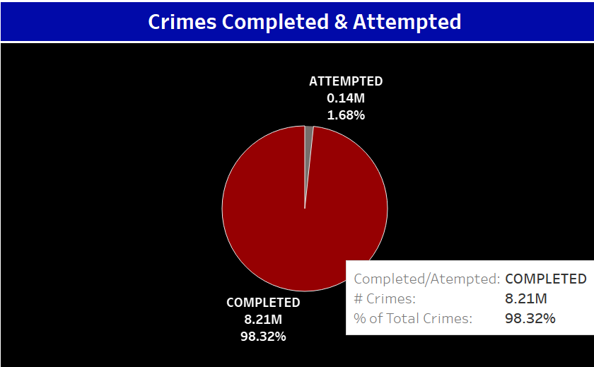
In the 5th Visualization, which is a bar chart which states the suspect and victim age grouping by crimes. Wanted to show which age group of suspects are targeting which age group people. As seen from the visualization above , I have grouped the ages as shownSo, from analyzing the graph, we can state that most B group Suspects have been targeting the Group B age Victims. Individuals in the 25-44 age group may interact more closely with others in the same age range due to shared social circles, workplaces, or residential areas. Crimes may occur within these social networks.
Visualization 5 & 6:
In the 6th Visualization, have kept a pie chart of the crimes completed & attempted. From the above chart we can state that 98.32% of the crimes have been completed and 1.68% of the crimes just have been attempted which have not been completed.

Slide 15
Visualizations and analyses conducted using the datasets have yielded insightful findings. From a macro perspective, the dashboards showcase the correlation between crime rates, economic indicators, and law enforcement budgets. Specifically, the visualizations reveal patterns across different states, delve into crime types within a specific state, and explore the relationship between income levels and crime. Notably, the examination of NYC crime data over the years highlights a significant spike in 2006, emphasizing the importance of understanding socio-economic factors and law enforcement strategies in interpreting crime trends. In conclusion, this project underscores the necessity of a comprehensive, data-driven approach to tackling crime. By combining technology, community engagement, and strategic interventions, we can pave the way for effective crime prevention and contribute to building safer, more resilient communities. The findings and visualizations presented here serve as a foundation for ongoing discussions and actions aimed at creating a society where safety is a collective endeavor. One effective way to inform law enforcement and contribute to crime reduction is through the establishment of community crime watch programs. These programs empower local residents to actively participate in the safety of their neighborhoods by collaborating with law enforcement agencies. By fostering open communication channels, residents can share information about suspicious activities or concerns, enabling law enforcement to respond promptly and strategically. Regular community meetings, where law enforcement officers provide updates on recent crime trends and safety measures, help build trust and strengthen the partnership between the police and the community. Additionally, leveraging technology, such as community-specific mobile apps or online platforms, can facilitate real-time reporting and information-sharing. By actively involving citizens in the crime prevention process, law enforcement gains valuable insights, and the community becomes an integral part of the solution, contributing to safer and more secure neighborhoods.
Conclusion

Slide 16
Datasets / References:
https://data.cityofnewyork.us/Public-Safety/NYPD-Complaint-Data-Historic/qgea-i56i
Crimes in US Communities Dataset (kaggle.com)
https://data.cityofnewyork.us/Public-Safety/NYPD-Hate-Crimes/bqiq-cu78

Slide 17


Thank You & Be Safe!!!!

